Slide 1

Computer Organization and Architecture
By-CHANDANA MN
20030141CSE060
BANDI RUPA SRAVYA
PROV/BTECH-CSE/LE-21/002
RAKSHITHA B
PROV/BTECH-CSE/LE-21/006
ASSIGNED BY-Dr.Senbagavalli M

Slide 2
Buses

Slide 3
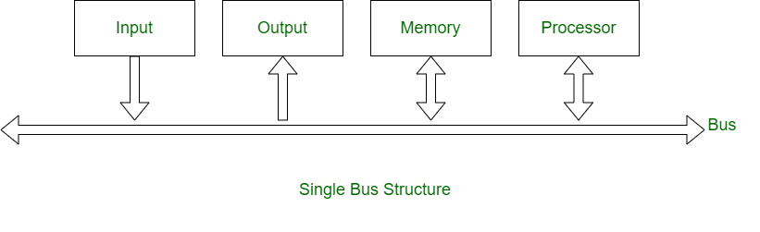
Bus
A bus is a high-speed internal connection. Buses are used to send control signals and data between the processor and other components.
A bus is a set of wires.
The elements of the computer are linked to the buses.
It can transfer data from one element to another, the source element outputs data onto the bus.
The destination element then inputs this information from the bus.
Buses use less area on a circuit board and need less power than a huge number of direct connections.
It can also need fewer pins on the chip or chips that includes the CPU.

Slide 4
Characteristics of bus
A bus is characterized by the amount of information that can be transmitted at once.
This amount, expressed in bits, corresponds to the number of physical lines over which data is sent simultaneously.
A 32-wire ribbon cable can transmit 32 bits in parallel.
The limitation of a bus is only one transmission at a time.
A bus which is used to provide communication between the major components of a computer is called a System bus.

Slide 5
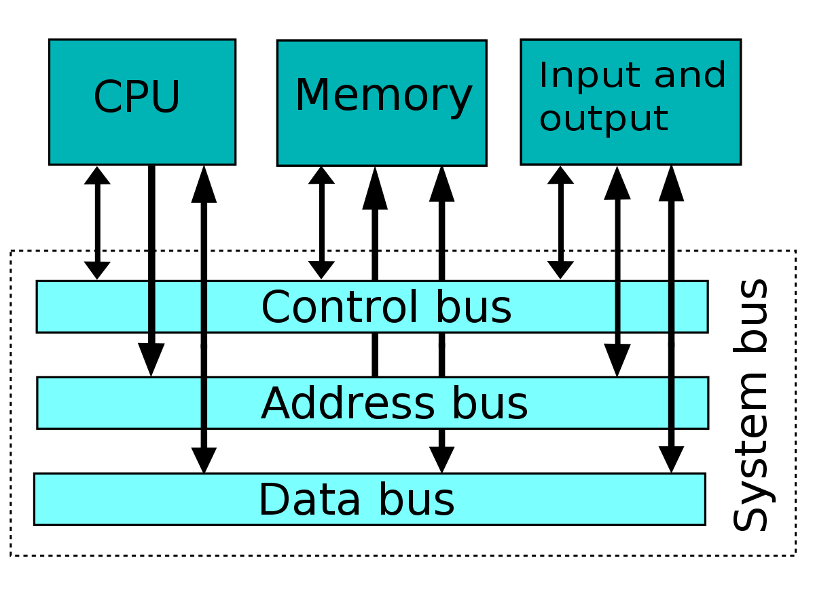
Types of System Buses
Address bus
Data bus
Control bus

Slide 6
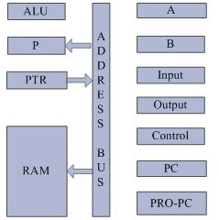
Address Bus:
Address bus carries memory addresses from the processor to other components such as primary storage and input/output devices.
The address bus is unidirectional.
It carries the memory address while reading from writing into memory.
It carries I/O post address or device address from I/O port.
In unidirectional address bus only, the CPU could send address and other units could not address the microprocessor.
Now a days computers are having bi-directional address bus.

Slide 7
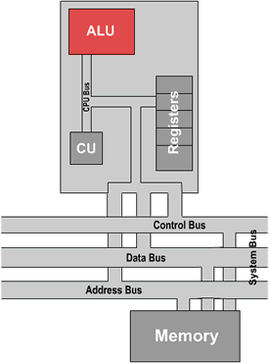
Data Bus
Data bus carries the data between the processor and other components.
The data bus is bidirectional.
It fetches the instructions from memory.
It is used to store the result of an instruction into memory.
It carries commands to an I/O device controller or port.
It carries data from a device controller or port.
It issue data to a device controller or port.

Slide 8
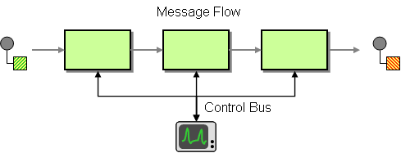
Control Bus:
Control bus carries control signals from the processor to other components.
The control bus also carries the clock's pulses.
The control bus is unidirectional.
Different types of control signals are used in a bus:
Memory Read: This signal, is issued by the CPU or DMA controller when performing a read operation with the memory.
Memory Write: This signal is issued by the CPU or DMA controller when performing a write operation with the memory.
I/O Read: This signal is issued by the CPU when it is reading from an input port.
I/O Write: This signal is issued by the CPU when writing into an output port.
Ready: The ready is an input signal to the CPU generated to synchronize the show memory or I/O ports with the fast CPU.
A system bus is a single computer bus that connects the major components of a computer system, combining the functions of a data bus to carry information, an address bus to determine where it should be sent, and a control bus to determine its operation.

Slide 9
Types of bus
Synchronous bus
Asynchronous bus

Slide 10
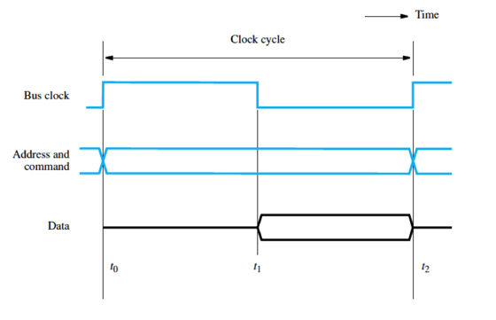
Synchronous bus:
A bus used to interconnect devices that comprise a computer system where the timing of transactions between devices is under the control of a synchronizing clock signal.
Includes a clock in the control lines
A fixed protocol for communication that is relative to the clock
Advantage:
involves very little logic and can run very fast
Disadvantages:
■ Every device on the bus must run at the same clock rate
■ To avoid clock skew, they cannot be long if they are fast

Slide 11
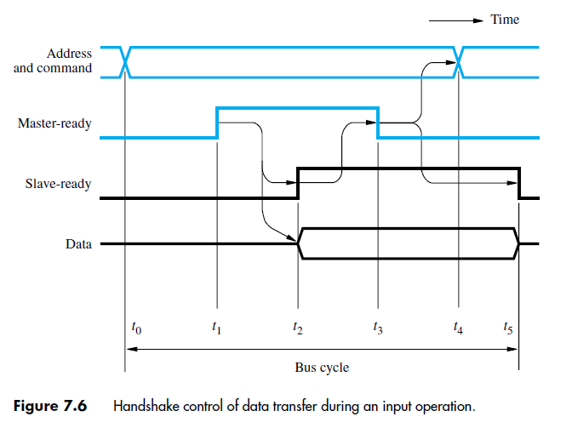
Asynchronous bus:
It is not clocked
It can accommodate a wide range of devices
It can be lengthened without worrying about clock skew
It requires a handshaking protocol
A bus that interconnects devices of a computer system where information transfers between devices are self-timed rather than controlled by a synchronizing clock signal. A connected device indicates its readiness for a transfer by activating a request signal.

Slide 12

Advantages of Bus:
It is the easiest network topology for connecting peripherals or computers in a linear fashion.
It works very efficient well when there is a small network.
It is easy to connect or remove devices in this network without affecting any other device.
Versatility:
New devices can be added easily
Peripherals can be moved between computer systems that use the same bus standard
Low Cost:
A single set of wires is shared in multiple ways
Manage complexity by partitioning the design

Slide 13
Disadvantages of Bus:
Bus topology is not great for large networks.
Identification of problem becomes difficult if whole network goes down.
Troubleshooting of individual device issues is very hard.
Need of terminators are required at both ends of main cable.
Additional devices slow network down.
If a main cable is damaged, whole network fails or splits into two.
Packet loss is high.
It creates a communication bottleneck
The bandwidth of that bus can limit the maximum I/O throughput
The maximum bus speed is largely limited by:
The length of the bus
The number of devices on the bus
The need to support a range of devices with:
Widely varying latencies
Widely varying data transfer rates

Slide 14


